Slide 1
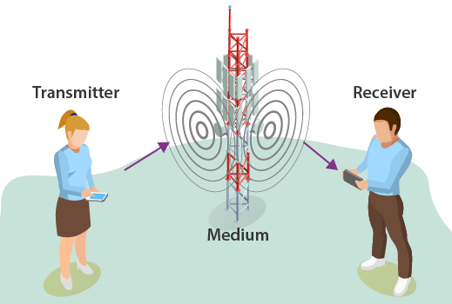

Introduction to Communication System
Sirisha Tadepalli

Slide 2
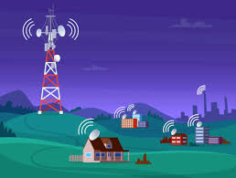
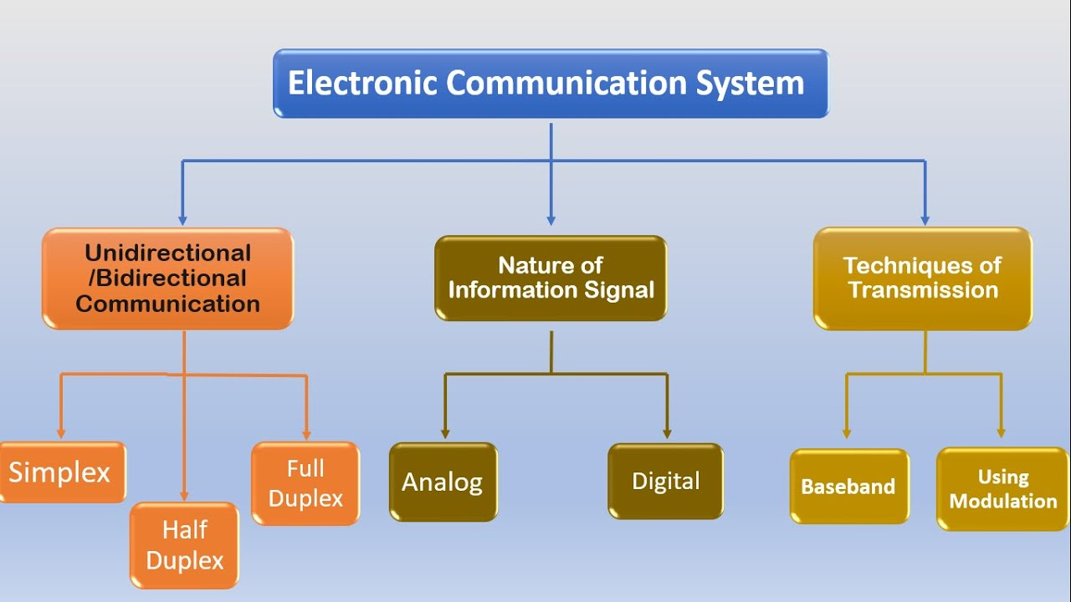
What is a Communication system?
The transmission of information is called communication
Information can be exchanged by one-to-one or one-to-many or many-many (Fig. 2)
It can be wired or wireless (Electronics view)
Fig. 2 Basic Information can be transmitted: one-to-many
Ex: Radio Broadcasting [3]
Fig.1 Basic classification of an electronic communication system [4]
Notes:
https://www.youtube.com/watch?v=qhjj6WG7Rgc

Slide 3
Why communication engineering for AI?
Foundational understanding for applying AI models
Ex: Human-machine interaction, Machine-to-machine interaction, Computer Vision, and Natural language processing (NLP)
Hardware Interaction: Many AI systems are designed to interact with the physical world through sensors and actuators.
Understanding communication engineering principles helps you grasp how these devices convert data into electrical signals and vice versa. Ex: IoT
Efficient Data Transmission: Communication engineering knowledge equips you with techniques for optimizing data transmission and minimizing errors. Ex: Autonomous vehicles
Notes:
Computer Vision (CV): Facial recognition systems, Self-driving cars, Augmented reality (AR) GPS
NLP: Voice assistants: SIRI,ALEXA. Machine translation, Smart replies and text suggestions:

Slide 4
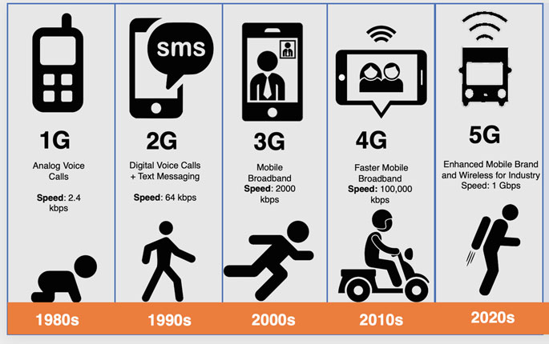
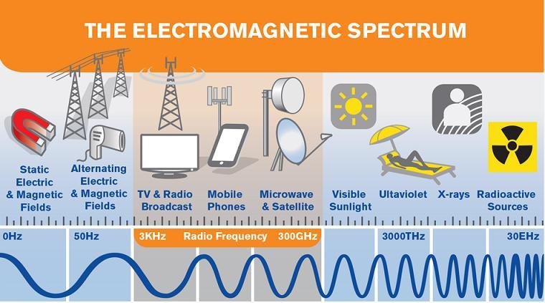
Evolution of mobile technology

Slide 5
Syllabus
Unit 1
Introduction to communication systems, introduction to signals, different types of signals and their characteristics, concept of system, linear time-invariant (LTI) system, sinusoids- concept of frequency, in-phase and quadrature component, bandwidth, pass band and stop band, Introduction to SDR platforms and devices- MATLAB Simulink and GNU radio Companion (GRC), RTL-SDR and Adalm Pluto. Signal analysis/ spectrum analysis and visualization using SDR tools.
Unit 2
Need for modulation, analog modulation schemes, amplitude modulation (AM) and its types - AM-DSB-SC, AMDSB-TC, SSB. AM Demodulation schemes, angle modulation- frequency modulation (FM) -Narrowband and wideband, phase modulation, FM demodulation, implementation of analog modulation/demodulation schemes using SDR tools.
Unit 3
Quadrature amplitude modulation and demodulation, pulse analog modulation schemes, digital carrier modulation/demodulation Schemes- amplitude shift keying (ASK), frequency shift keying (FSK), phase shift keying (PSK), M-ary signaling, BPSK, QPSK, implementation of digital modulation/demodulation schemes using SDR tools. Multicarrier modulation- OFDM, MIMO, Prospects of AI in communication system- radio signal or modulation classification.

Slide 6
Reference textbooks
B1. Wyglinski, Alexander M., Robin Getz, Travis Collins, and Di Pu. Software-defined radio for engineers. Artech House, 2018.
B2. Qasim Chaudhari, Wireless Communications from the Ground Up: An SDR Perspective, 2018
B3. Andrew Barron, Software Defined Radio: for Amateur Radio Operators and Shortwave Listeners, 2019
B4. C.R. Johnson and W.A. Sethares, Software Receiver Design: Build Your Own Digital Communication System in Five Easy Steps, Cambridge University Press, 2011
B5. Proakis, John G., Masoud Salehi, and Gerhard Bauch. Contemporary communication systems using MATLAB. Cengage Learning, 2012.
B6. Wyglinski, Alexander M., and Di Pu. Digital communication systems engineering with software defined radio. Artech House, 2013.

Slide 7
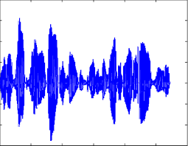
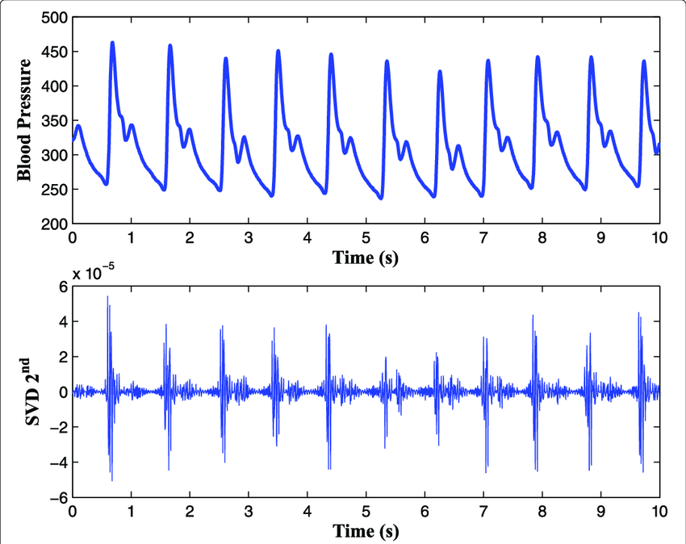
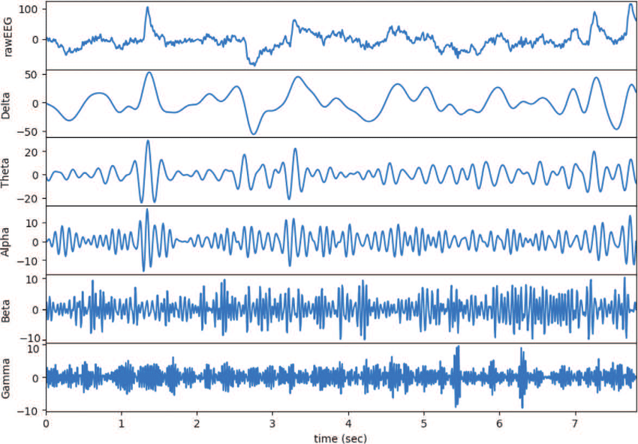
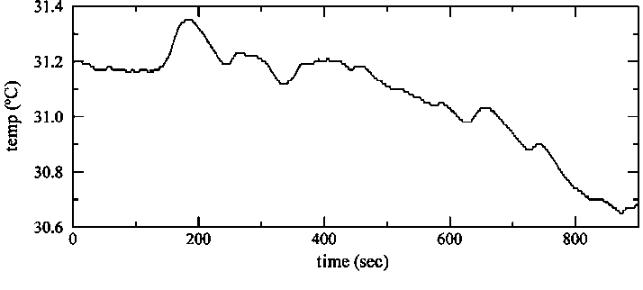
Introduction to signals
What is a signal?
A fundamental quantity of representing information
Information can be of any form
Ex: Analog, digital, Sound, temperature, intensity, Pressure, etc..,
Notes:
In maths it’s a function

Slide 8
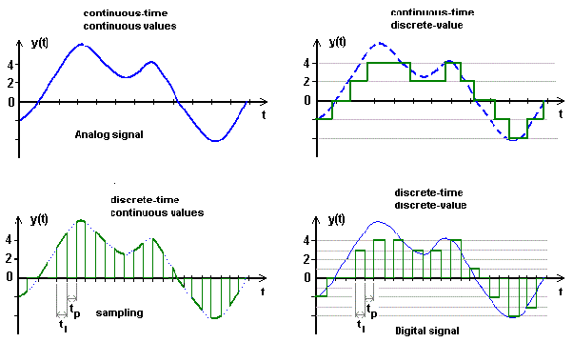
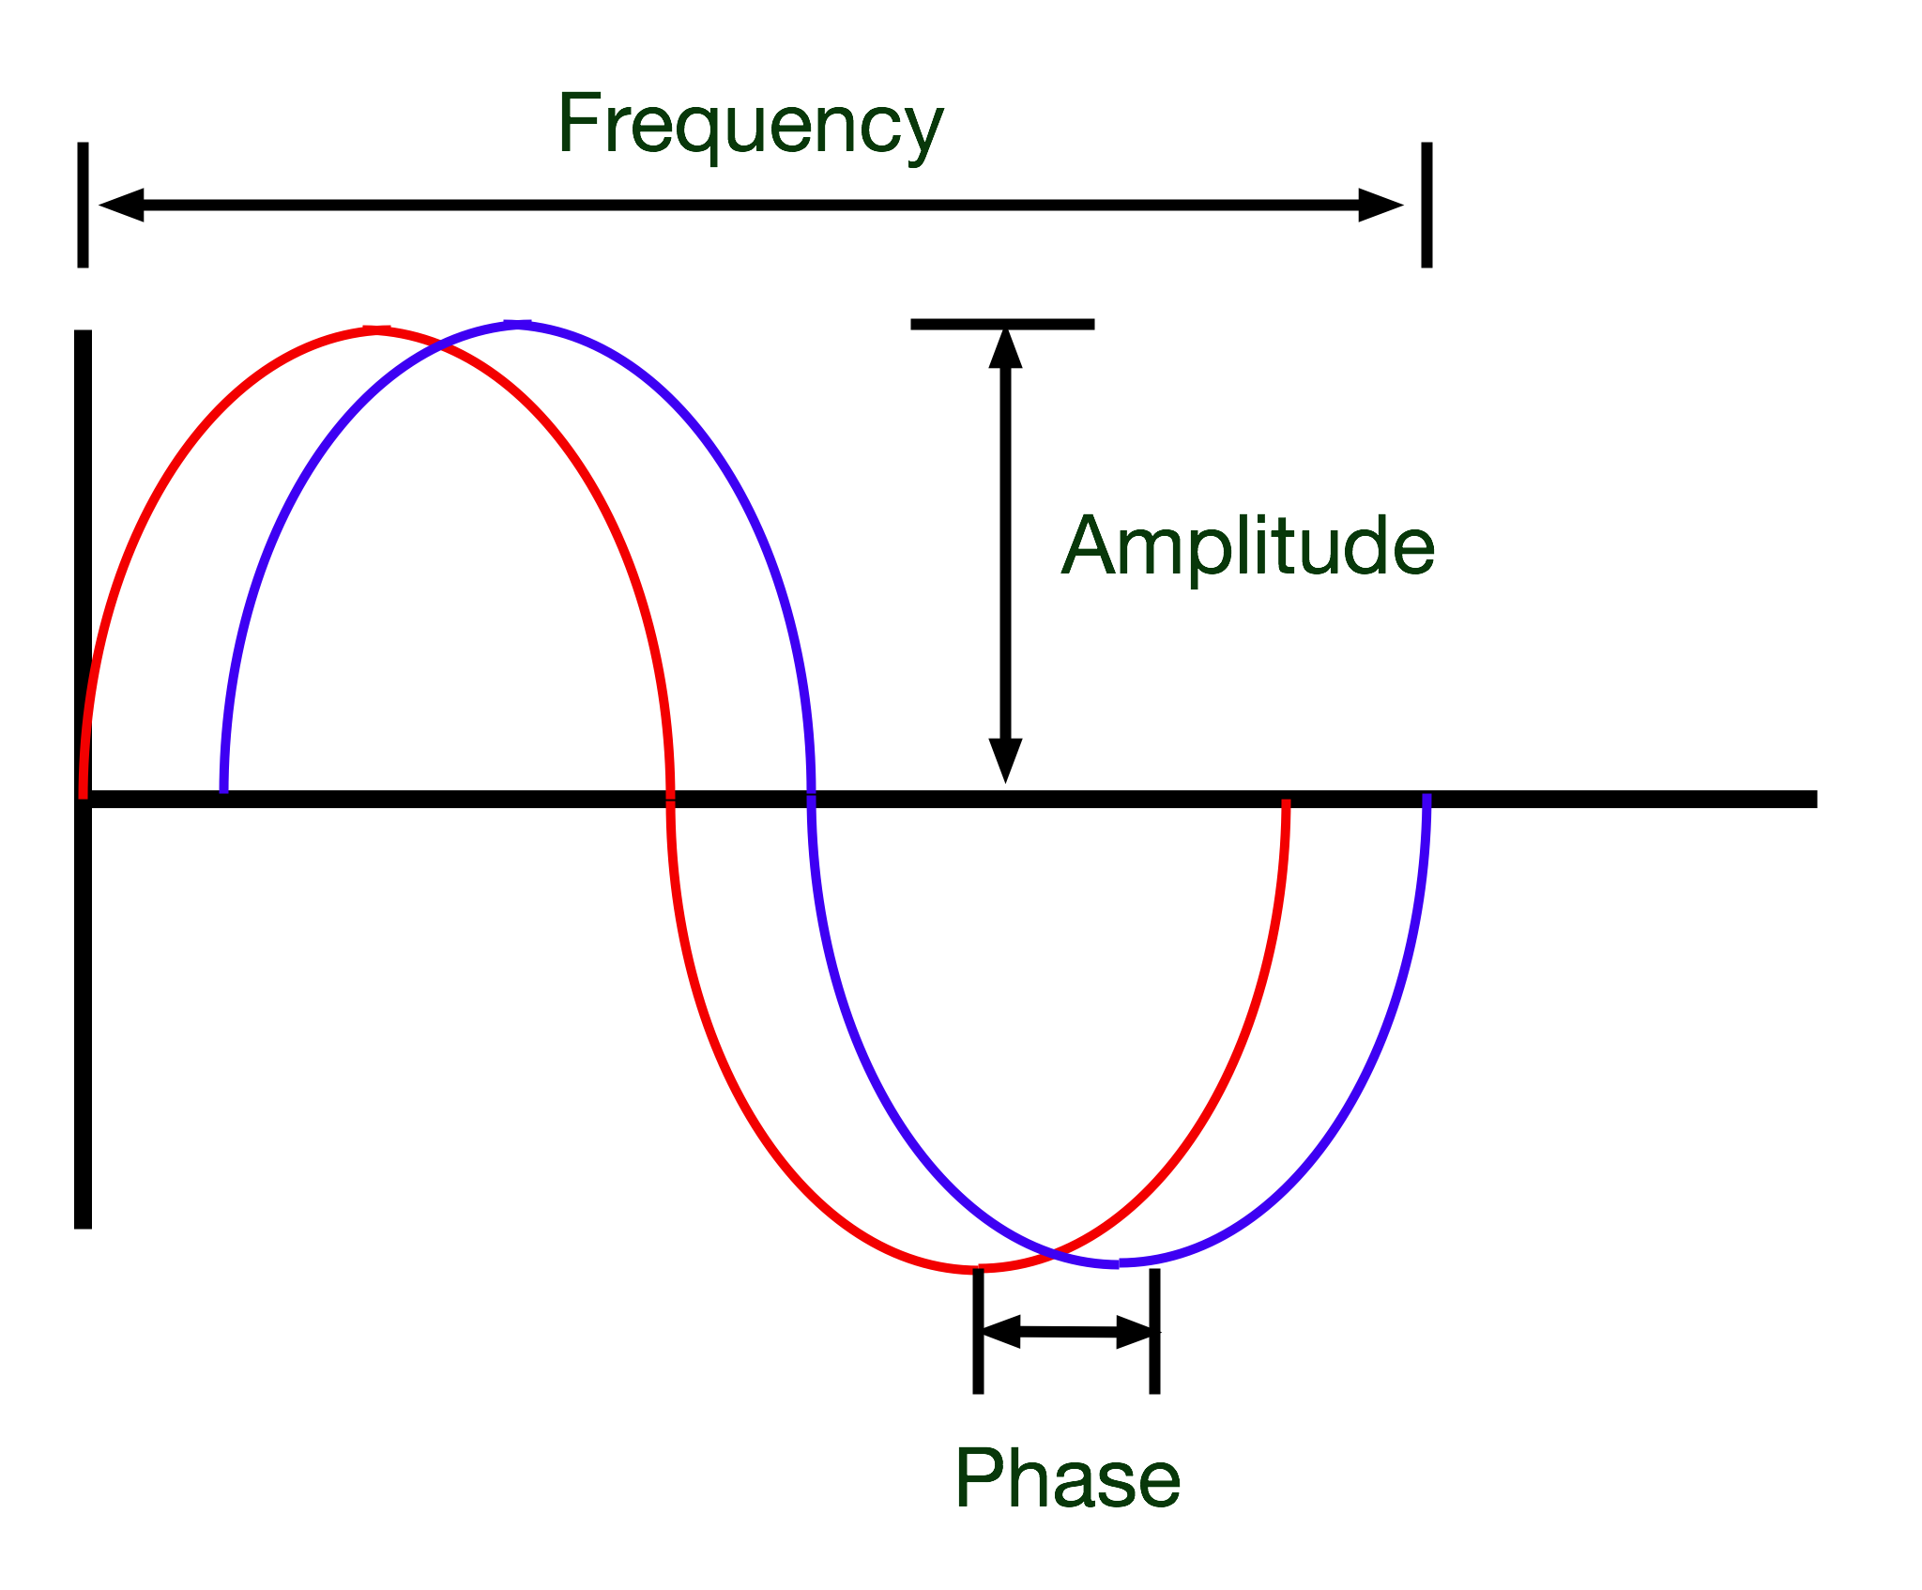
Types of Signals: or classification
1. Analog signal: continuous t and continuous y(t)
2. Continuous-time signal: continuous t and discrete y(t)
3. Discrete signal: discrete t and continuous y(t)
4. Digital signal: discrete t and discrete t
Characteristics of a signal
Amplitude (height)
Frequency (width)
Phase (angle)
1
2
3
4

Slide 9
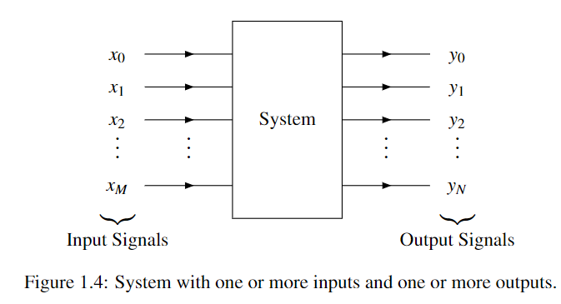
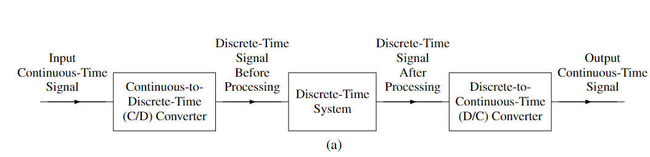
Classification of systems
A system is an entity that processes one or more input signals to produce one or more output signals
Classification:
No. of inputs: SISO, MIMO
Type of signal: Continuous-time system, discrete-time, hybrid system, and digital or analog systems
One-dimensional and multi-dimensional
Example: Speech recognition system
Amplification and noise reduction
ECG abnormalities detection system

Slide 10
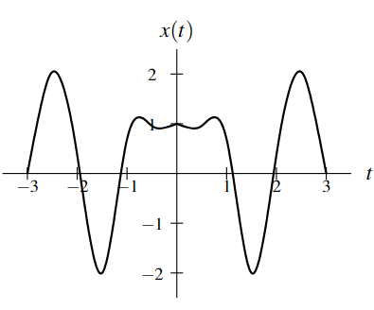
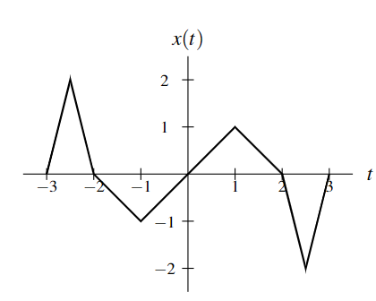
Symmetry of Functions and Sequences
Even
Even and Odd signals
A function x is said to be even if it satisfies
x(t) = x(-t) or x(n) = x(-n)
Geometrically, an even function or sequence is symmetric with respect to the vertical axis
A function x is said to be odd if it satisfies
x(t) = - x(-t) for all t (where t is a real number)
x(n) = −x(−n) for all n (where n is an integer)
One can easily show that an odd function or sequence x must be such that x(0) = 0, assuming that the domain of x includes 0
Odd

Slide 19
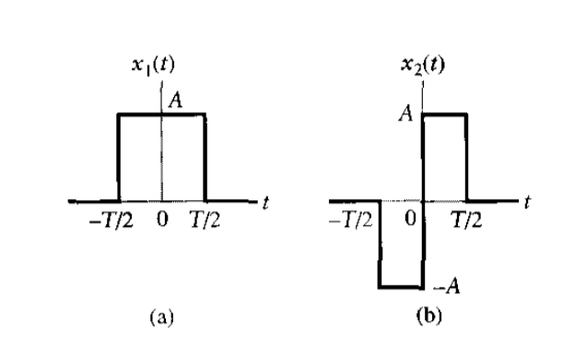
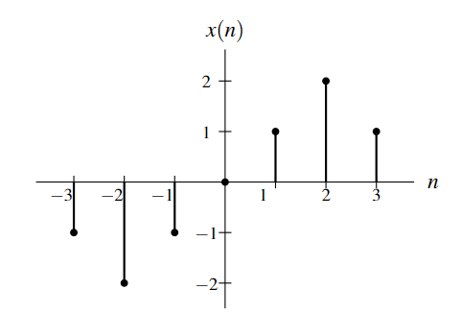
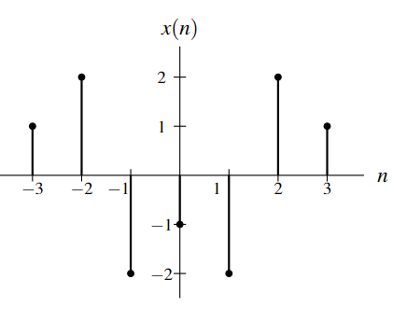
Examples

Slide 20
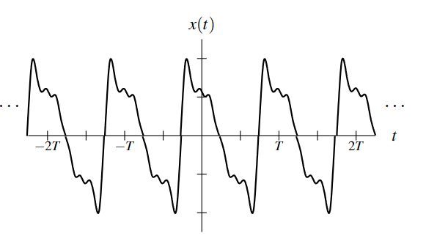
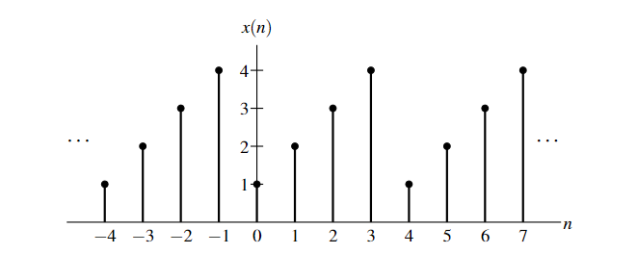
Periodicity of Functions and Sequences
A function x is said to be periodic with period T (or simply T -periodic) if, for some strictly positive real constant T
x(t) = x(t + T ) for all t (where t is a real number)
A T-periodic function x is said to have the frequency 1/T and angular frequency 2π/T
A sequence x is said to be periodic with period N (or simply N-periodic) if, for some strictly positive integer N,
x(n) = x(n + N) for all n (where n is an integer)
An N-periodic sequence x is said to have a frequency 1/N and angular frequency 2π/N
A function or sequence that is not periodic is said to be Aperiodic.

Slide 21
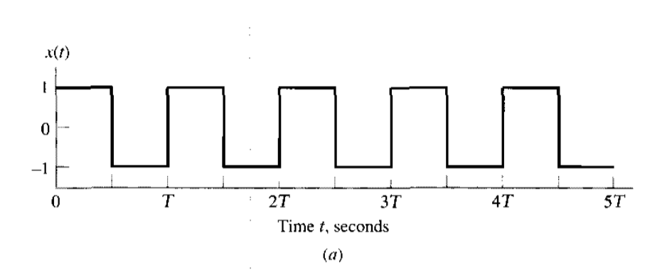
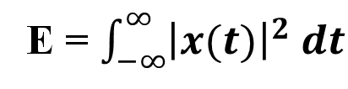
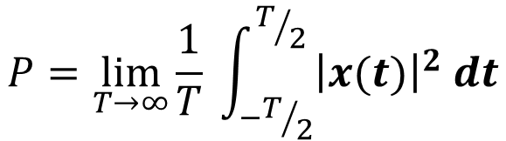
What is the frequency of the signal? If T =0.2s
Signal Energy and Power
The energy E contained in the function x is defined as
The average power P contained in the function x is given by
E = $\int_{−∞}^{∞}{{\left|x(t)\right|}^{2} dt}$
$$P=\lim_{T→∞}{\frac{1}{T}} \int_{−T/2}^{T/2}{{\left|x(t)\right|}^{2} dt}$$

Slide 22
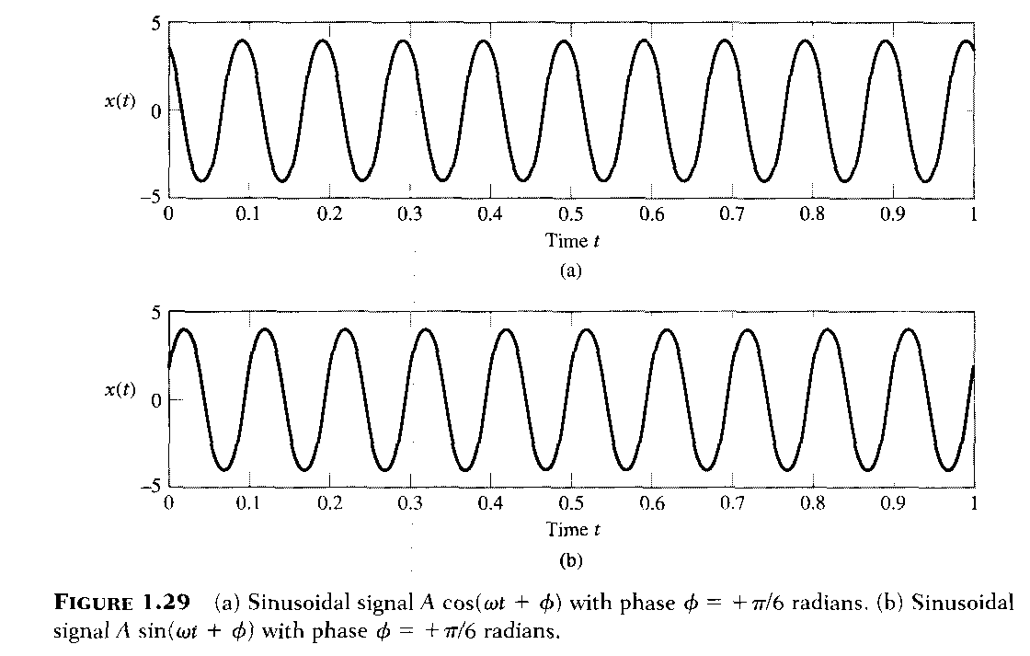

Slide 23
Unit step Function
The unit-step function (also known as the Heaviside step function), denoted u(t), is defined as
Ramp function
Ramp function, r(t) is defined as

Slide 24
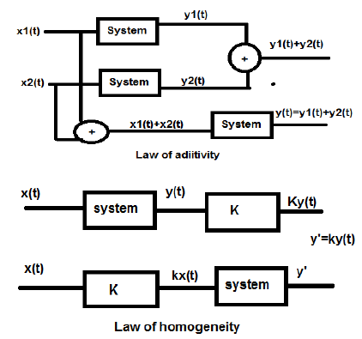
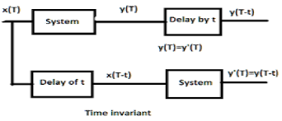
Linear time-invariant system (LTI)
Linear system and Time invariant system → LTI system
Linear system follows superposition: Law of additivity and Law of homogeneity
Time invariant system

Slide 25
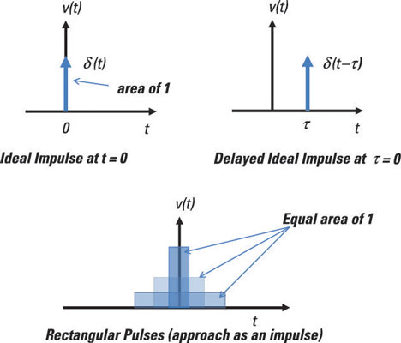
Linear time-invariant system (LTI)
Why the LTI system?
The effect of a system on the spectrum of a signal can be analyzed easily if and only if the system is LTI
Impulse response
x(t) = δ (t) y(t) = h(t)
unit impulse Impulse response
The impulse response completely characterizes the behavior of an LTI system
δ[n − i] → LTI → h[n − i] (Time-invariance–works for any constant i)
System
Notes:
https://www.castle.cloud/gnuradio-for-windows/download/- GNUcompanion

Slide 26
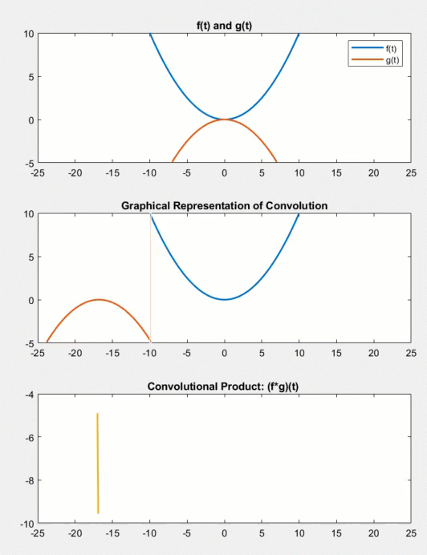
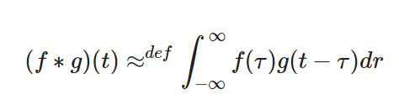
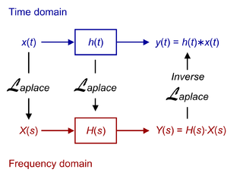
Linear time-invariant system (LTI)
convolution is an integral that expresses the amount of overlap of one function 𝑓(𝑡), as it is shifted over function 𝑔(𝑡), for a continuous-time signal it is expressed as:

Slide 27
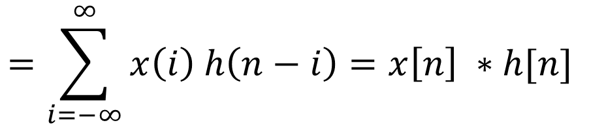
Linear time-invariant system (LTI)
For a Discrete signal
x[n] → LTI → y[n]
$$=\sum_{i=−∞}^{∞}{x\left(i\right) h\left(n−i\right)=x\left[n\right] ∗h[n] }$$
If the length of vector x is N and the length of vector h is M
The response vector Y of length M+ N -1:
In other words, length(y) = length(x) + length(h)- 1:
If the nonzero values of x[n] are in the interval [ax, bx] and the nonzero values of h[n] are in the interval [ah, bh] then the nonzero values of the output y[n] are in the interval [ax + ah, bx + bh]:

Slide 28

Qn. Consider an LTI system with impulse response
Find the response of the system to input signal
Sol:
$$x\left[n\right]=δ\left[n\right]$$
Since both
Similarly, we can obtain

Slide 29
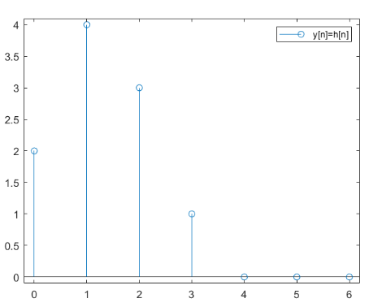
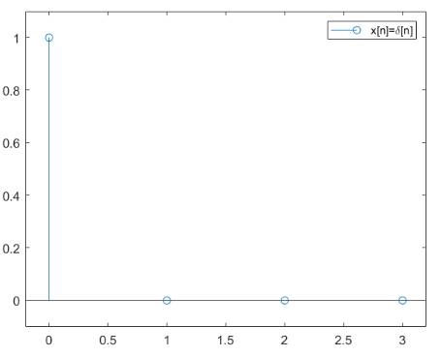
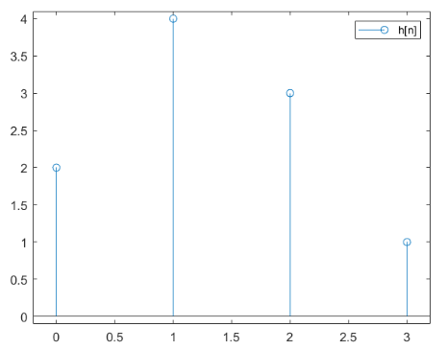
Verification : Computationally
What will be the response y[n] for input $δ\left[n−1\right]$ ?

Slide 30
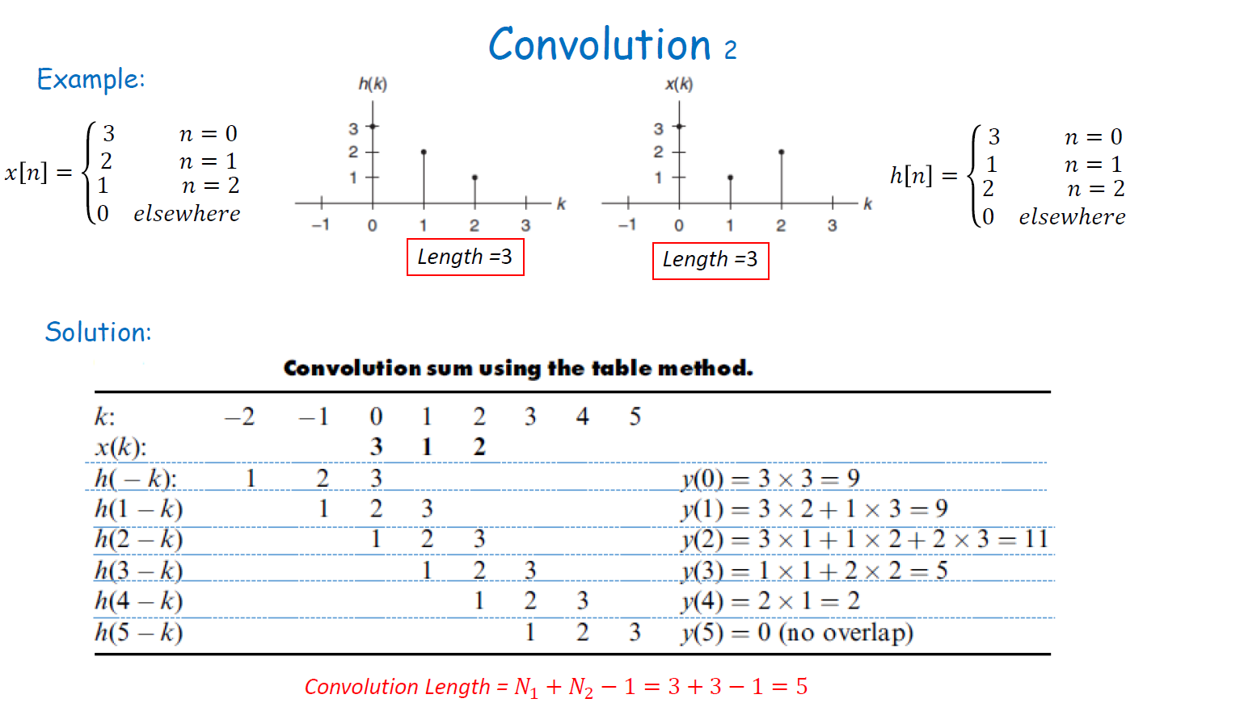

Slide 31
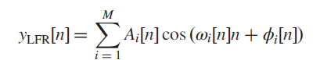
Sinusoids
Why do we need to study Sinusoids?
Used in communication systems
Any signal can be represented as the sum of sinusoids
Many systems can be characterized by their response to sinusoids
For eg. Modulation schemes
Speech signal in low frequency region (80-400 Hz)
Eg. Filters, Equalizers

Slide 32
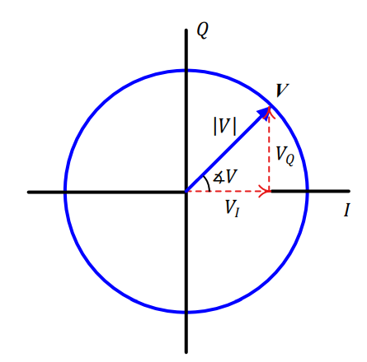
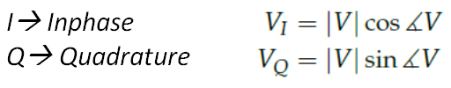
Complex number
V is a complex number in this IQ-plane

Slide 33
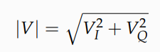
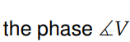
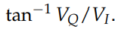
Magnitude and Phase

Slide 34
Complex Sinusoid
V rotating anticlockwise in a circle at a constant rate with time
Instead of a complex number V, now V(t) can be treated as a signal with time as independent variable and we call it a complex sinusoid.
Complex sinusoid is made up of 2 real sinusoids

Slide 35
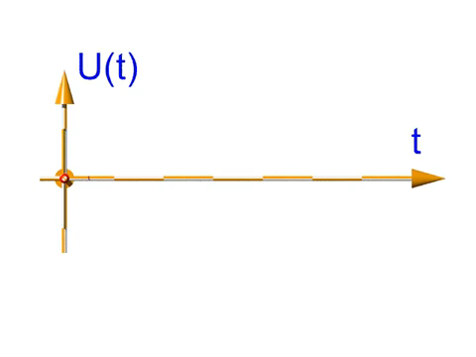
Complex Sinusoid

Slide 36
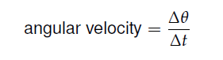
Concept of Frequency
A constant rate implies that in any given duration Δt, the change in phase Δ is
a constant
V rotating anticlockwise in a circle at a constant rate with time
The frequency of this complex sinusoid

Slide 37
Inphase and Quadrature Component
Observe the projection of v(t) into 2D plane
Projection from a 3D to a 2-D plane formed
by time and I-axis
Inphase part
Projection from a 3D to a 2-D plane formed by time and Q-axis
Complex sinusoid with frequency F is composed of two real sinusoids
Quadrature Part

Slide 38
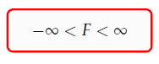
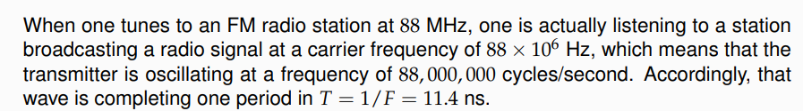
F is the continuous frequency with units of cycles/second or Hertz (Hz).
Range of continuous frequency values

Slide 39
In summary
Frequency is the rate of rotation of a complex sinusoid in time IQ-plane
This rate of rotation can be changed from very slow (close to 0) to as fast as possible (close to +∞)
A clockwise direction of rotation implies a negative frequency, while anti-clockwise rotation implies a positive frequency
Anti-clockwise rotation (+ve F) = I. cosθ ─ Q. sinθ; Q. cosθ + I. sinθ
Clockwise rotation (-ve F) = I. cosθ + Q. sinθ; Q. cosθ ─ I. sinθ

Slide 40
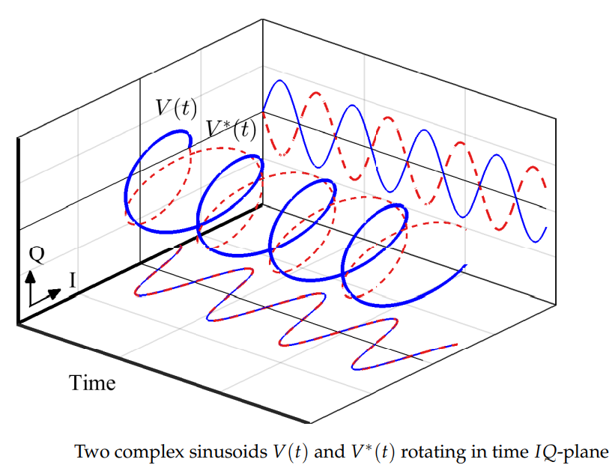
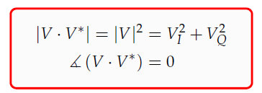
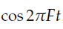
Real Sinusoid
How to produce only one real sinusoid in complex IQ-plane?
Rotating two complex sinusoids in opposite directions to each other
V(t) with a frequency F shown as solid blue line while V*(t) with frequency −F shown as dashed red line
The I parts exactly fall on top of each other and hence are the same cos 2πFt
The Q parts carry exactly the same amplitude with opposite signs to each other and hence are sin 2πFt and − sin 2πFt, respectively.
Observations
I parts :
Q parts :

Slide 42
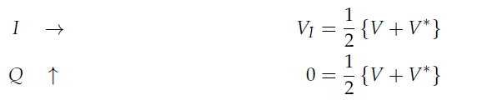
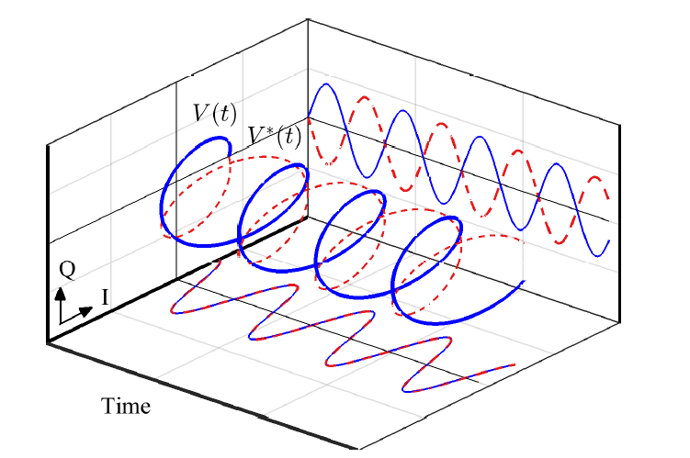




Addition of 2 complex sinusoids
Subtraction of 2 complex sinusoids
Complex sinusoid:
Frequency Domain representation

Slide 43



Real cosine
A frequency domain representation of a cosine wave should be two impulses, one at frequency +F due to V(t) and the other at frequency −F contributed by V∗(t).

Slide 44



Real sine
what is the frequency domain representation of a sine wave on time and I-axis?
By rotating the time waveform clockwise by
90◦, the sine wave can be put on time I-axis

Slide 45




Complex sinusoids form a basic unit of signal construction of any shape
5 sinusoidal components adding together to generate the approximate square wave in the time domain.

Slide 46



Spectrum and Bandwidth
Spectrum contains the frequencies of complex sinusoids that sum up in time domain to form that signal
Bandwidth of a signal is the range of frequencies of complex sinusoids present in that signal
Band-limited signal
Signals with fast irregular variations
wide bandwidth
Notes:
## A band-limited signal is then referred to as a signal with most of its energy concentrated within a certain amount of
frequency range.
## For example, Federal Communications Commission (FCC) defines bandwidth as the band in which 99% of the signal power is contained

Slide 47
Frequency Support
A signal cannot be limited in both time and frequency domains.
A band-limited signal is then referred to as a signal with most of its energy concentrated within a certain amount of frequency range.
For example, Federal Communications Commission (FCC) defines bandwidth as the band in which 99% of the signal power is contained.

Slide 48



Sampling a Continuous-Time Signal
Sampling is the conversion of a continuous-time signal into a discrete-time signal obtained by taking the samples of the continuous-time signal at discrete-time instants
A continuous-time signal in time and frequency domains
Sampling a continuous-time signal
Consider a band-limited continuous-time signal s(t) and its frequency domain representation S(F) with bandwidth B shown in above Figure
A discrete-time signal s[n] can be obtained by taking samples of s(t) at equal intervals of T_{S} seconds.
T_{S} = Sampling period or sampling interval
While F_{S} = Sampling frequency = 1/T_{S}

Slide 49



Consider a continuous-time signal
s(t) = Acos(2πFt + θ)
Sampling of the same signal at a rate Fs =1/Ts
= Acos (2πFnT_{S} + θ) = Acos (2πF n/F_{S} + θ )
= Acos (2π F/F_{S} n + θ)
F/Fs above is the frequency of a discrete-time sinusoid s[n]
_{Let us} sample at the same rate Fs another sinusoid with continuous frequency F+kFs, where _{k = ±1,±2, · · ·}
s[n] = Acos {2π(F + kFs)nTs + θ}
_{This expression is the same as} _{the discrete-time sinusoid}
Therefore, the sampling process output makes its impossible to distinguish between two discrete-time signals whose frequencies are Fs Hz apart.

Slide 50


Spectrum after sampling. Dotted red lines indicate the baseband or
Nyquist band
If a continuous-time signal has a bandwidth B greater than 0.5Fs, it will appear as an alias

Slide 51
Digital Filters
In signal processing, the function of a filter is to remove unwanted parts of the signal, such as random noise, or to extract useful parts of the signal, such as the components lying within a certain frequency range.
The primary functions of a filter are:
To confine a signal into a prescribed frequency band or channel for example as in an anti-aliasing filter or a radio/TV channel selector,
To decompose a signal into two or more sub-band signals for sub-band signal processing, for example in music coding,
To modify the frequency spectrum of a signal, for example in audio graphic equalizers, and
To model the input-output relation of a system such as a mobile communication channel, voice production, musical instruments, telephone line echo, and room acoustics.

Slide 52

Nyquist Rate or Sampling theorem
The highest frequency (or bandwidth) B of a continuous-time signal s(t) should be less than 0.5Fs to prevent any distortion in the sampled signal s[n]

Slide 53

Passband and Stopband

